Slide 1
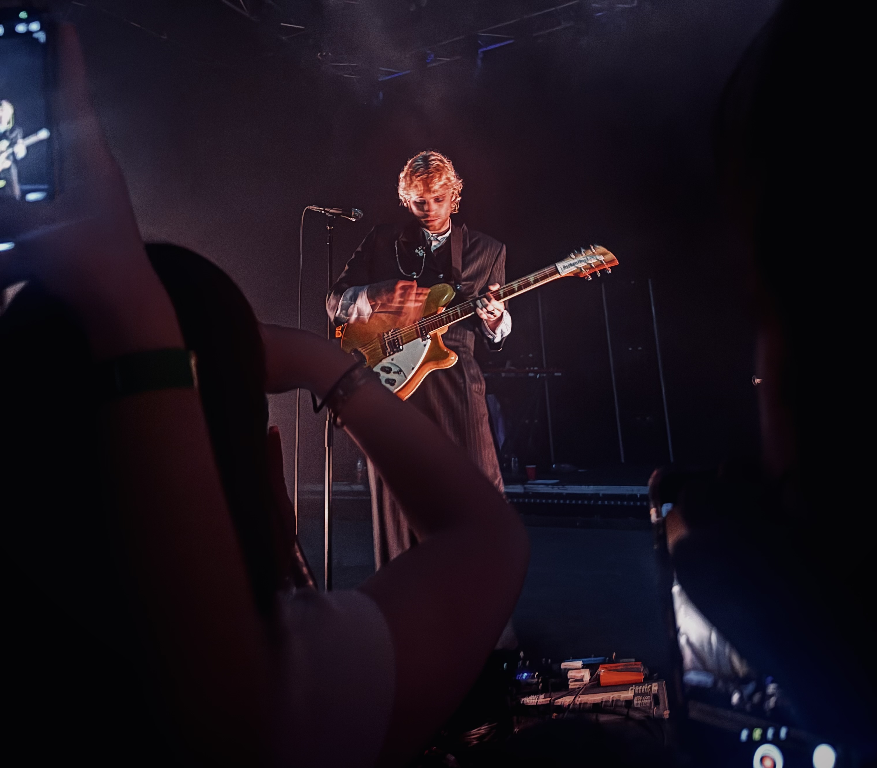
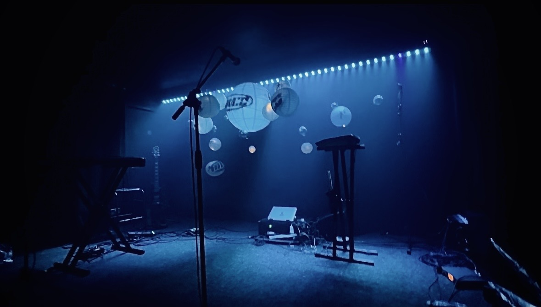
FMP

Slide 2

Context:
Throughout my time in college, I have learnt many skills within each of my projects for example:
Project 1 'Hiding Under the Covers'.
Project 2 'What a Wonderful World'.
Project 3 'On the Road'.
Project 4 'Skills Development'.
Project 5 'FMP 1'.
Project 6 'The Future'.
Project 7 'Genres'.

Slide 3
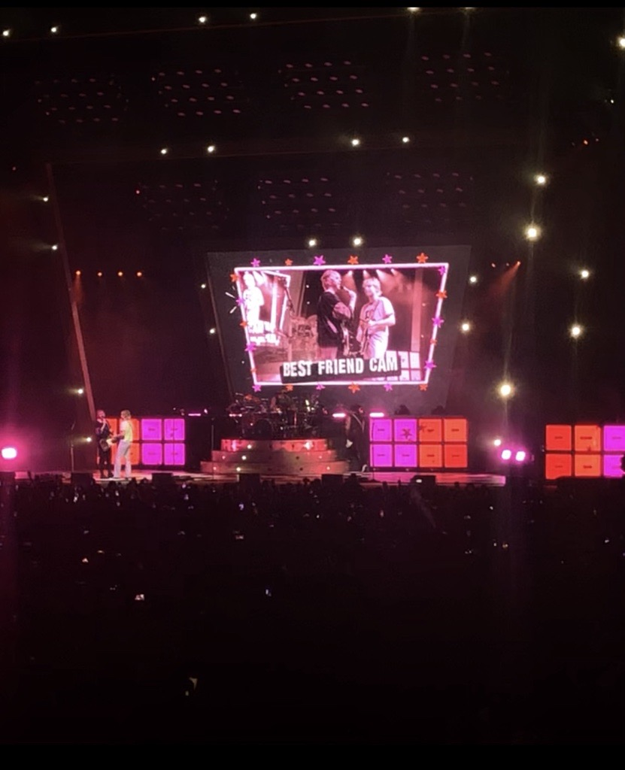
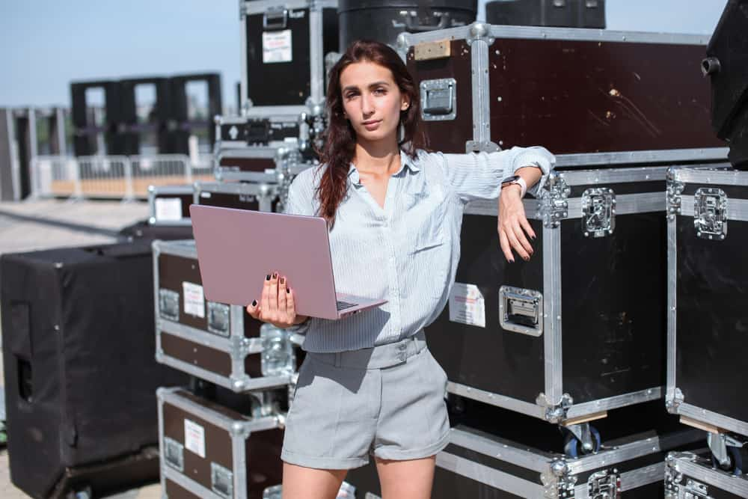


Research:
What Will I be doing for my research?
Management
Photography
Primary Research:
Secondary Research:

Slide 4

Problem solving:
What Problems may appear?
Not being able to find a venue.
Not having people within the class to play.
Not being able to have access to equipment within college.

Slide 5
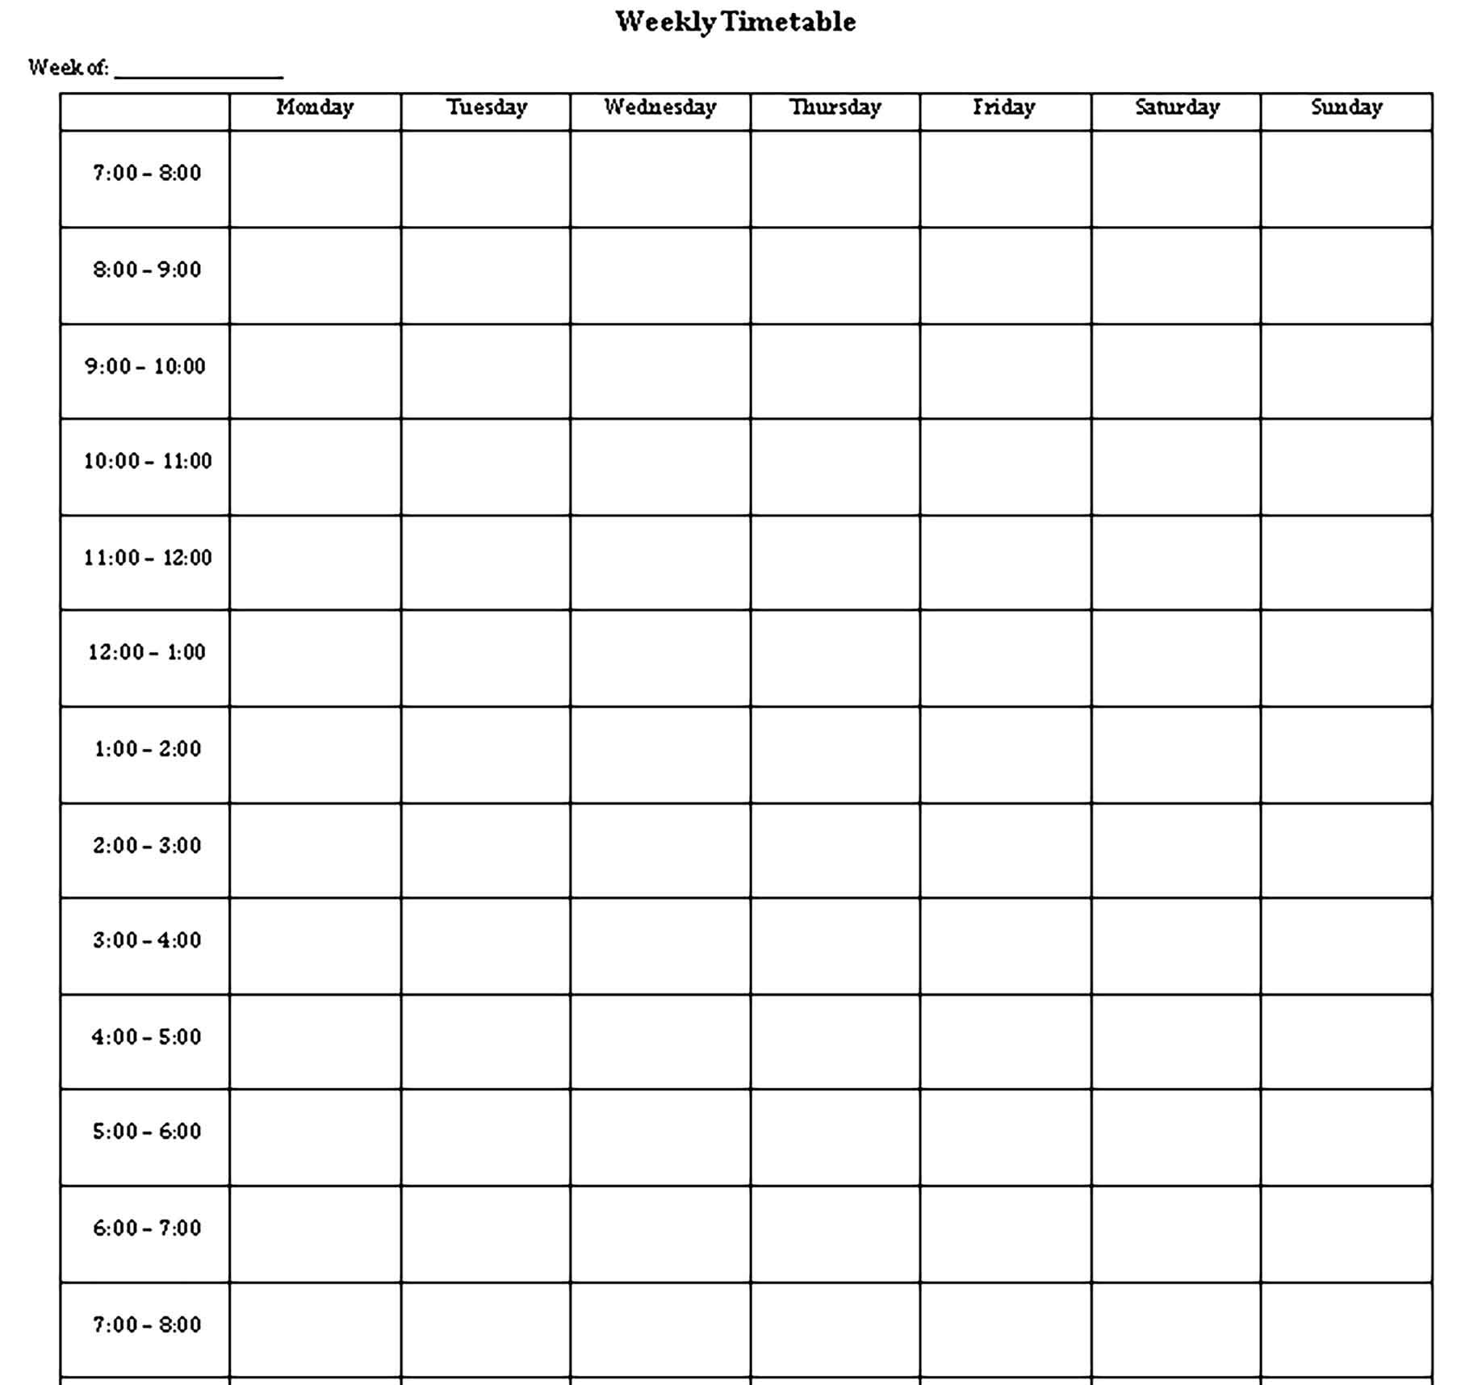

Planning and production:
What will I be doing to stay organised?
Timetable.
Blog.

Slide 6
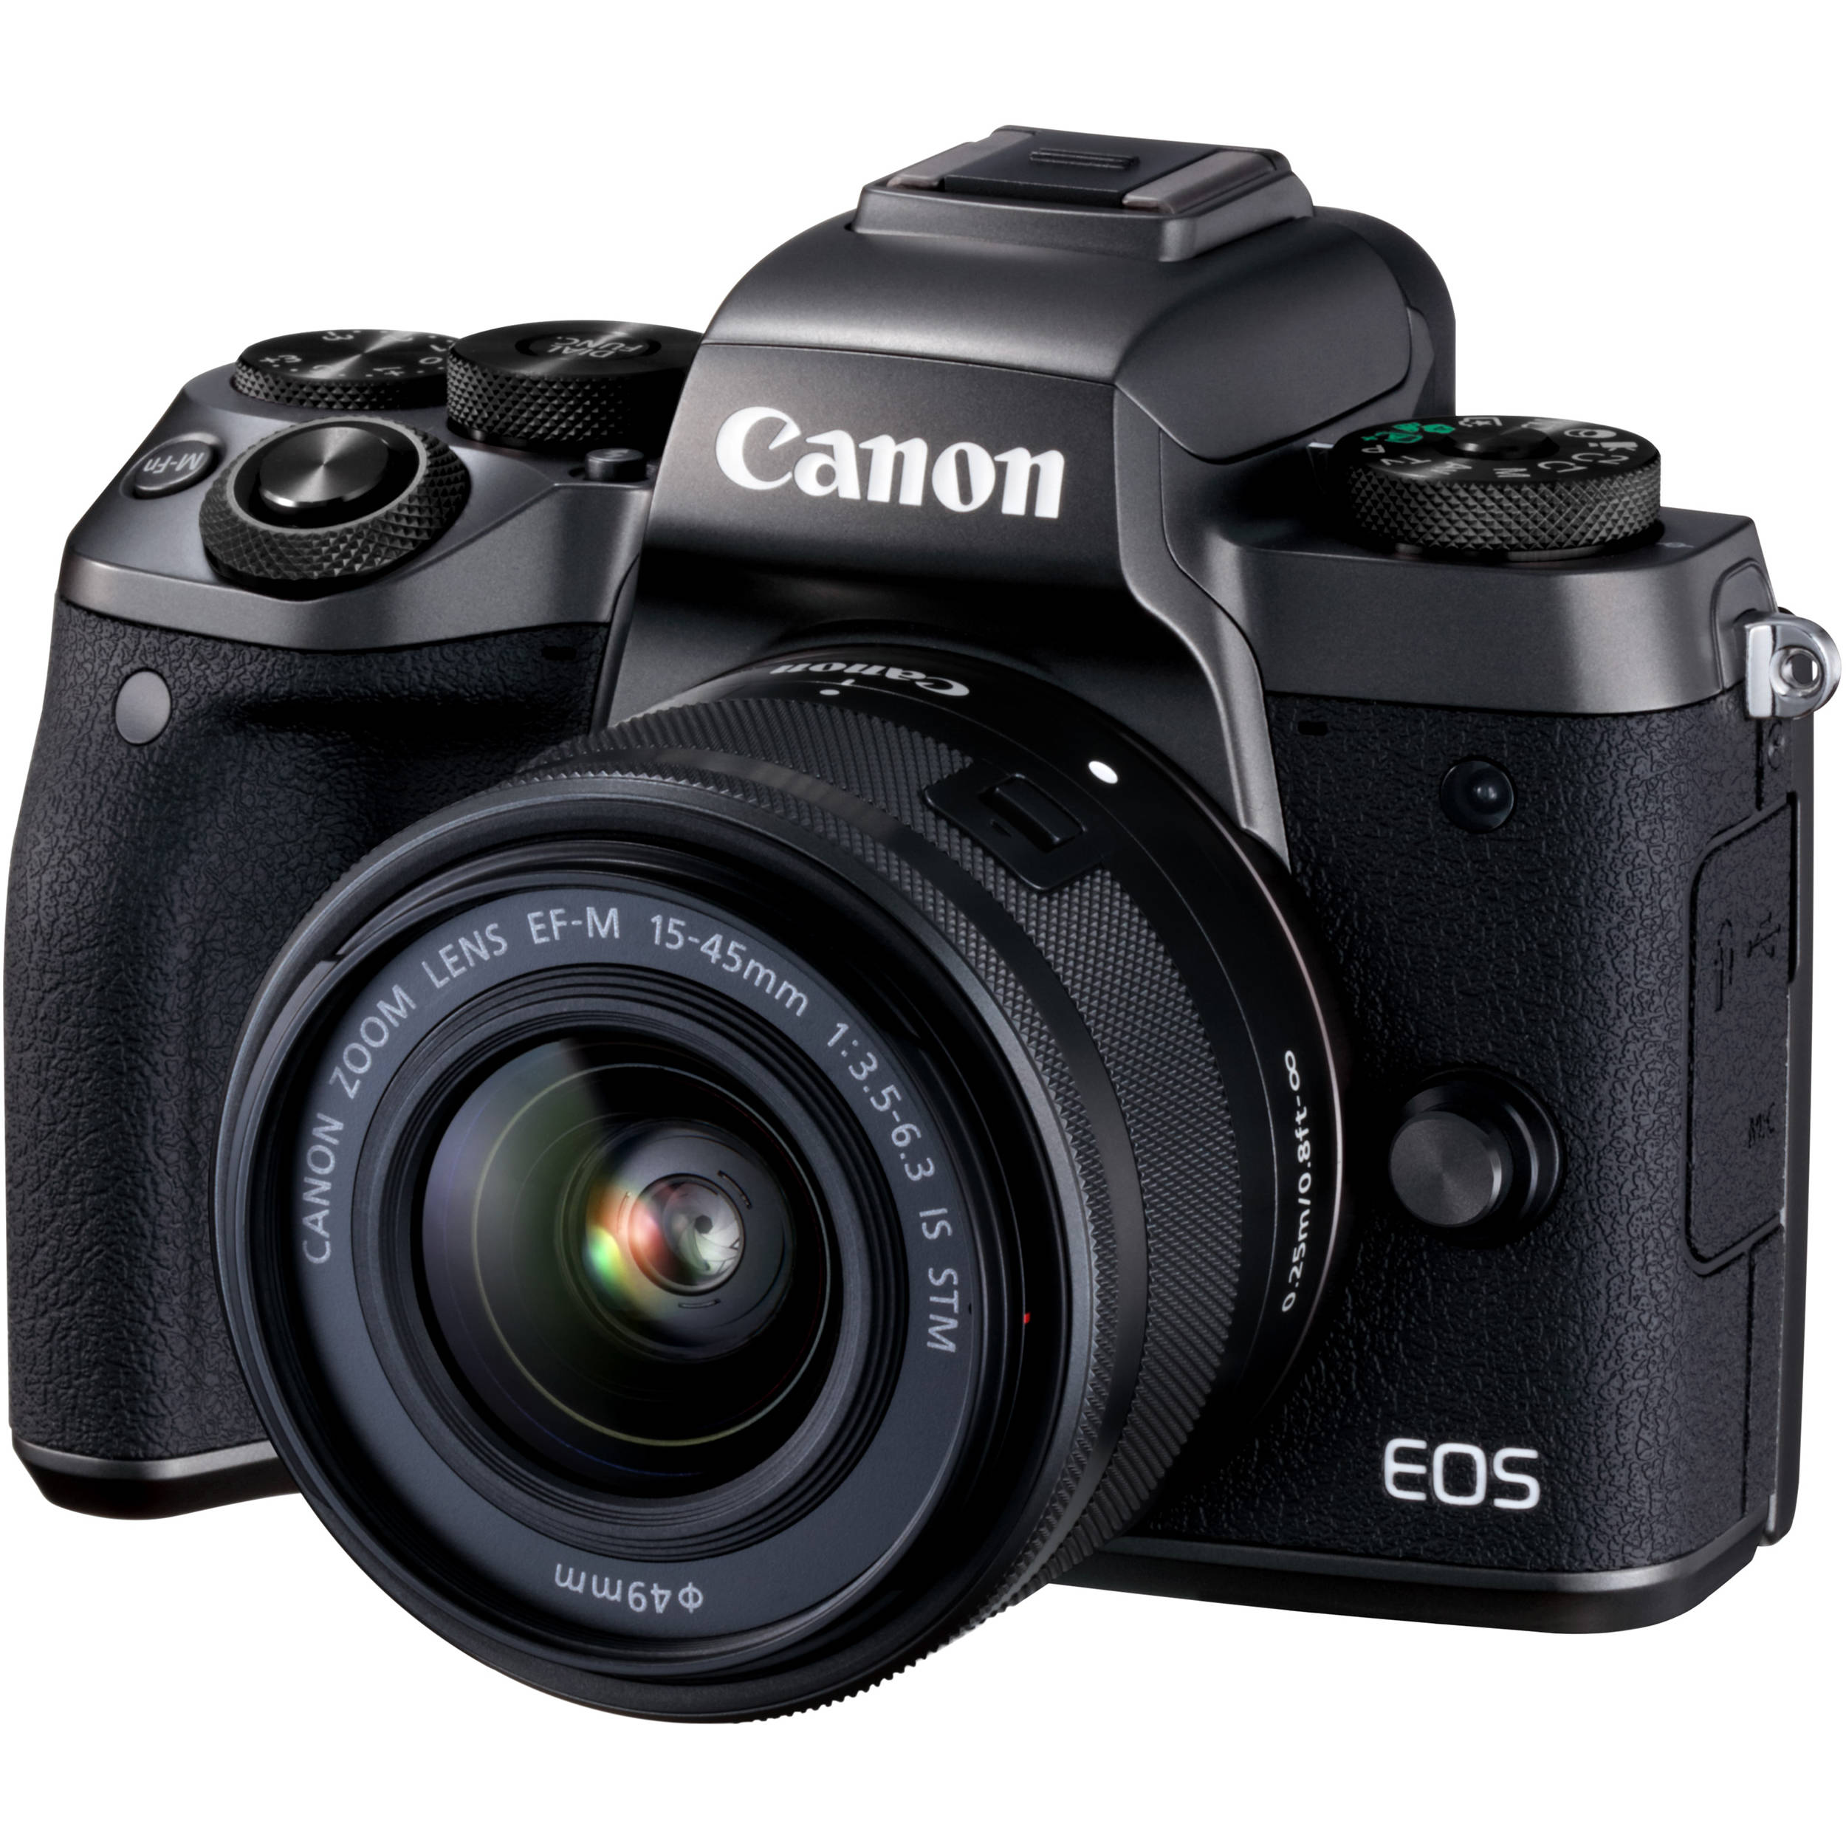
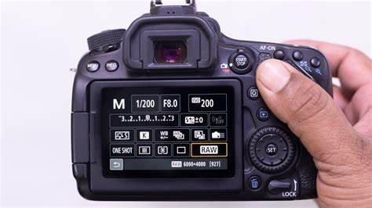
Practical Skills:
For my practical skills I will learn various things such as:
Settings.
Lenses.
Angles.

Slide 7

Evaluation and Reflection:
What will I be doing for my reflection?
Weekly Blogs.
What am I going to do for my evaluation?
The overall gig.
The outcome of my photos.

Slide 8
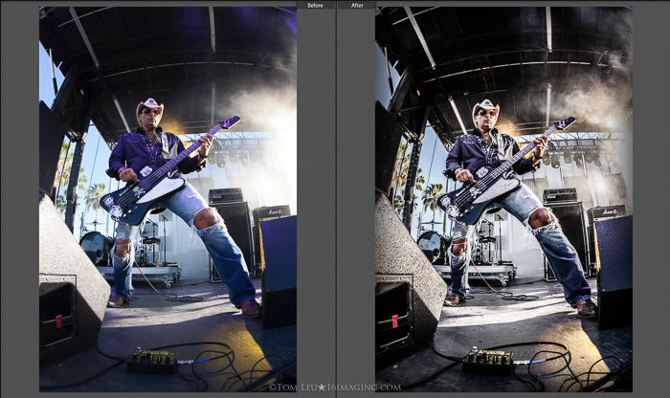
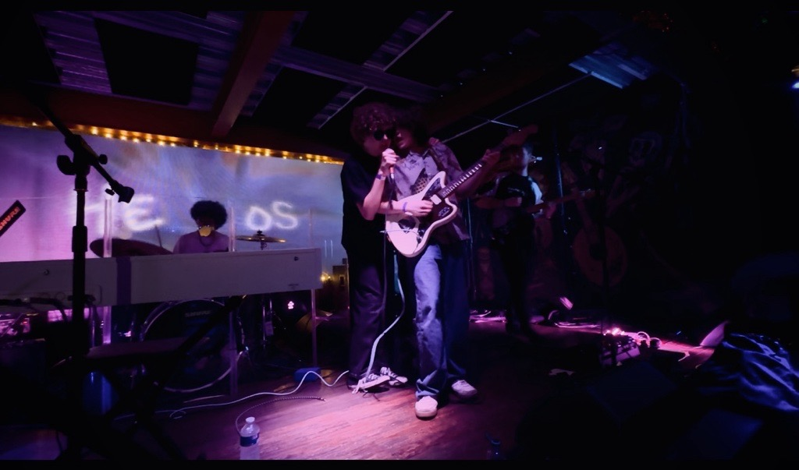
Presentation:
I will have two different things to present within my project:
The gig.
The photography.

